Slide 1
IBM University Engagement Project Submission
“Exploring the Power of Agentic AI with IBM Granite and LangFlow”

Slide 2

Project Tile – Health Insurance Assistance AI Agent
Domain of Project – Healthcare
Faculty Name | Recent Passport Photo | Email ID | Mobile number [WhatsApp]
Prasad Ramesh Phad |  | pphad036@gmail.com | 7588174461

Slide 3
Problem Statement -AI-Powered Health Insurance Assistant for Simplifying Insurance Selection, Claims, and Policy Understanding
The Challenge
Developing a Health Insurance Assistant AI Agent requires addressing complex insurance terminology, personalized recommendation requirements, data accuracy, regulatory compliance, privacy concerns, and real-time policy updates while ensuring reliable, secure, and user-friendly assistance for policy selection, comparison, and claims support.
The Objective
Simplify health insurance information for customers.
Help users compare and select appropriate insurance plans.
Provide personalized recommendations based on user needs and budget.
Guide users through policy enrollment and renewal processes.
Assist customers with claim procedures and required documentation.
Offer instant responses to common insurance-related questions.
Improve customer engagement and satisfaction.
Reduce support workload for insurance companies.

Slide 4
Technology Used
Tech Stack (Mandatory)
Use any one of the following approaches:
IBM Cloud
watsonx.ai studio
Watson-orchestrate

Slide 5
Proposed Solution -
Proposed Solution: Health Insurance Assistance AI Agent
The proposed solution is a multi-agent AI-powered Nutrition Agent built using IBM cloud, IBM watsonx.ai, Watson-orchestrate to provide solution of the problem statements.
Use Cases
Comparison of multiple health insurance plans.
Claims assistance and documentation guidance.
Explanation of premiums, deductibles, and waiting periods.
Network hospital lookup and coverage information.
Policy renewal reminders and support.
Frequently Asked Questions (FAQ) automation.
Policy recommendation based on age, family size, and budget.

Slide 6
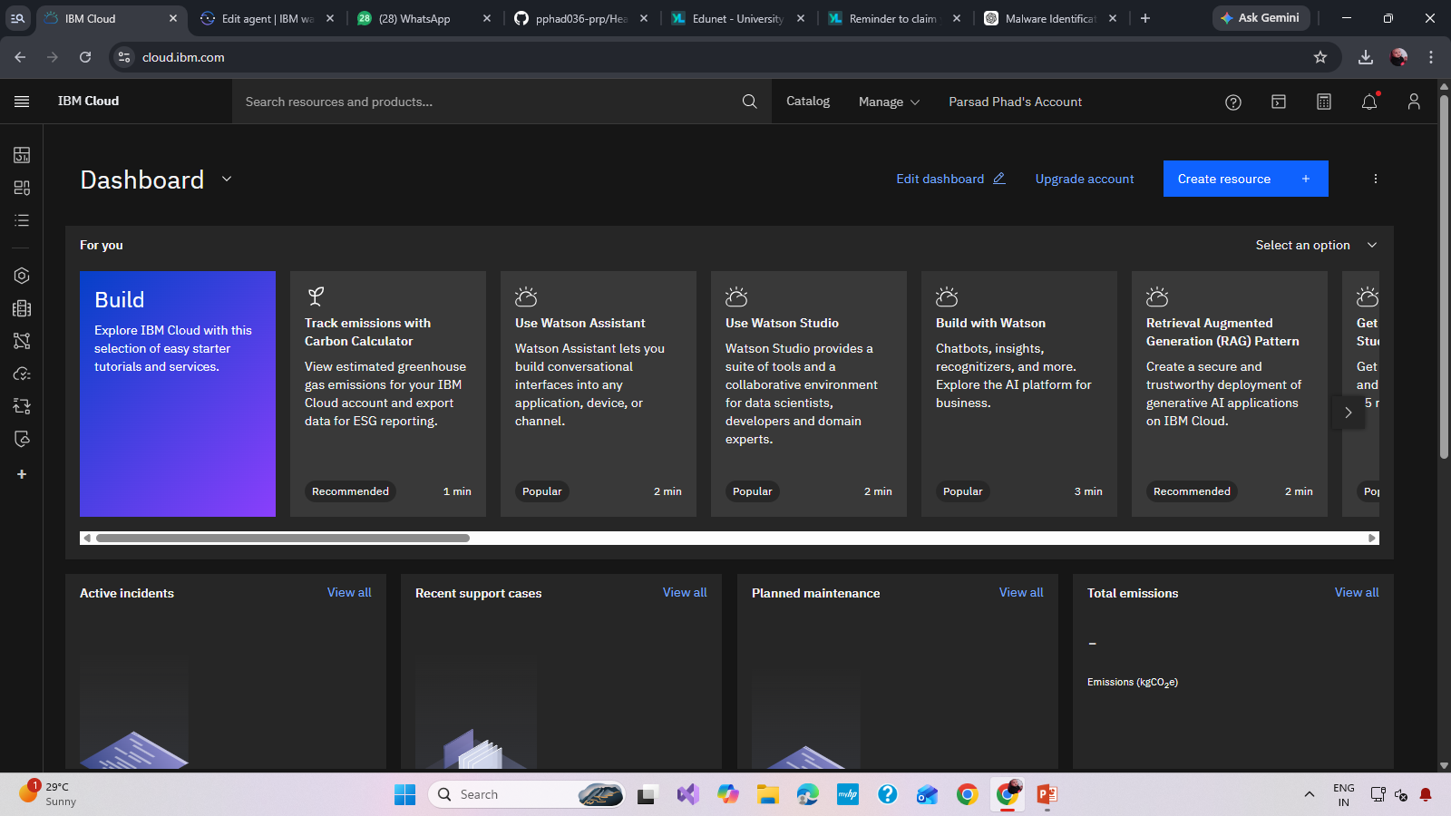
IBM Cloud Workflow

Slide 7
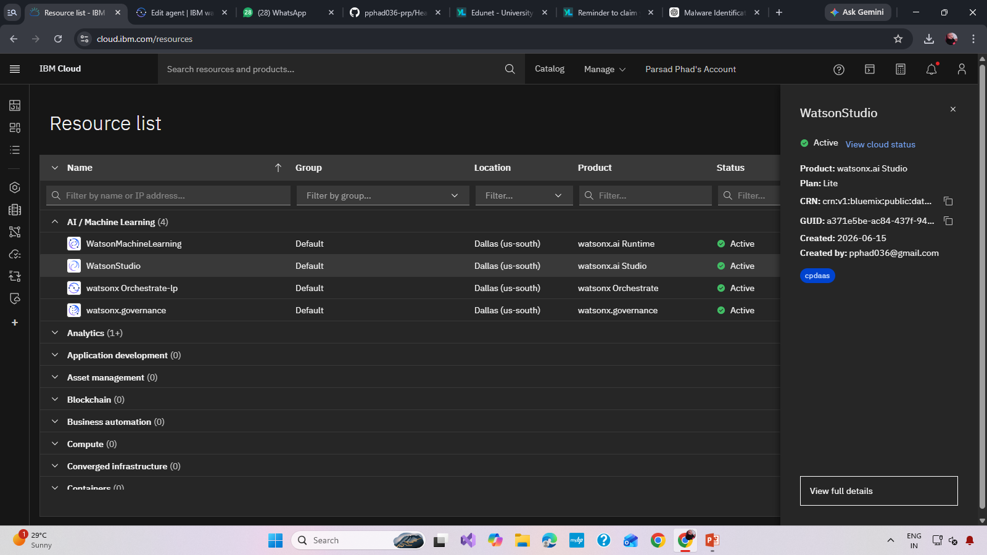
watsonx.ai studio workflow

Slide 8
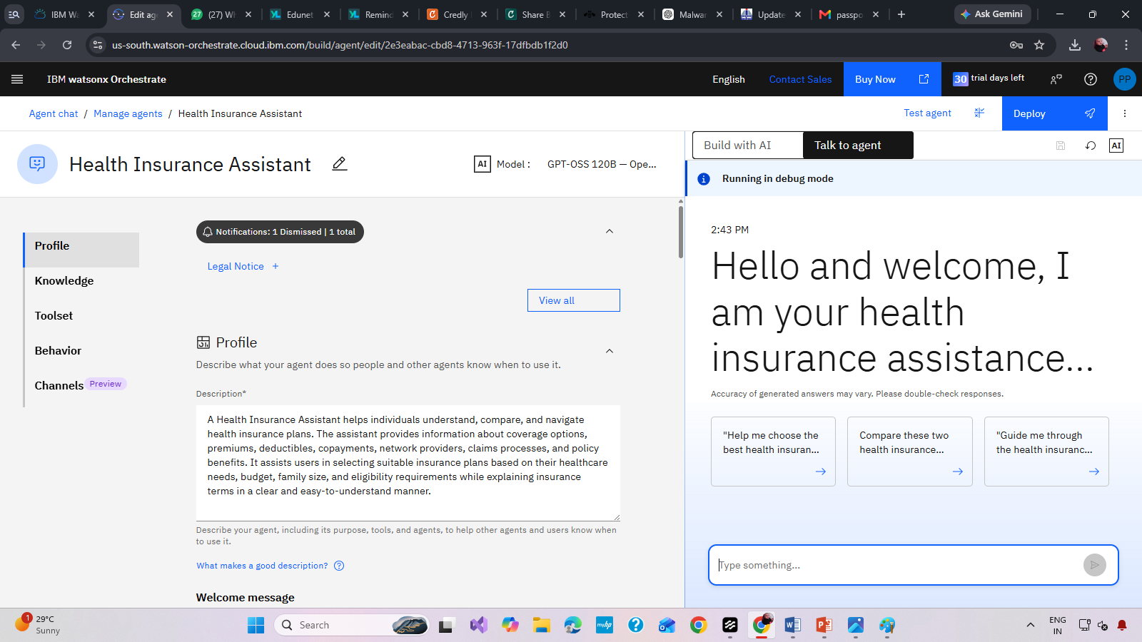
Watson-orchestrate workflow -

Slide 9
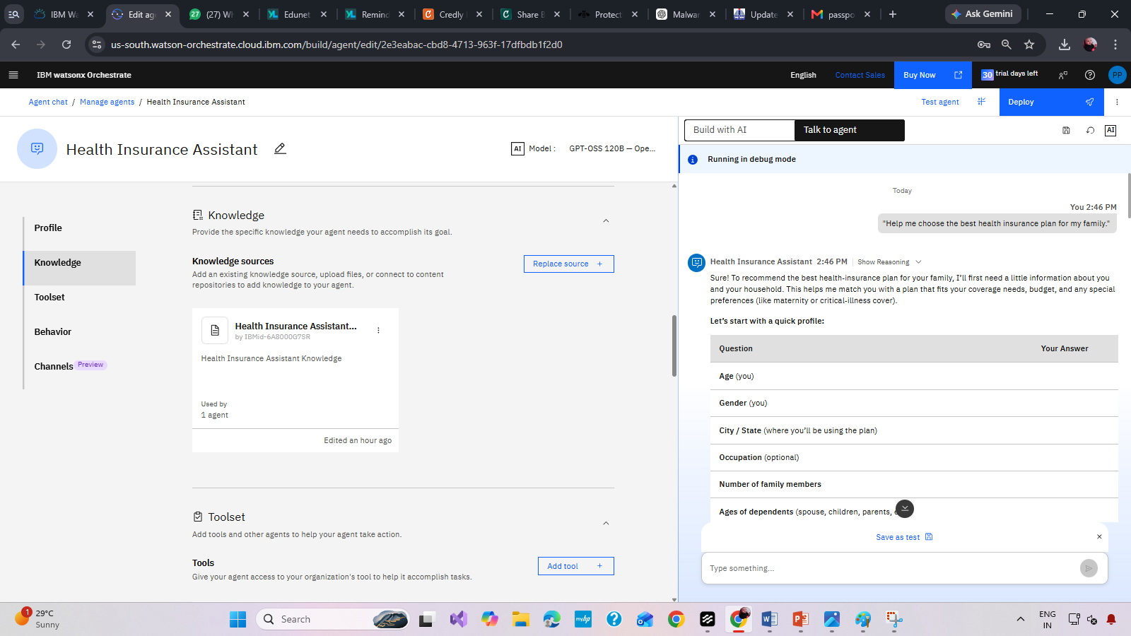
Test Health Insurance Assistance AI Agent

Slide 10
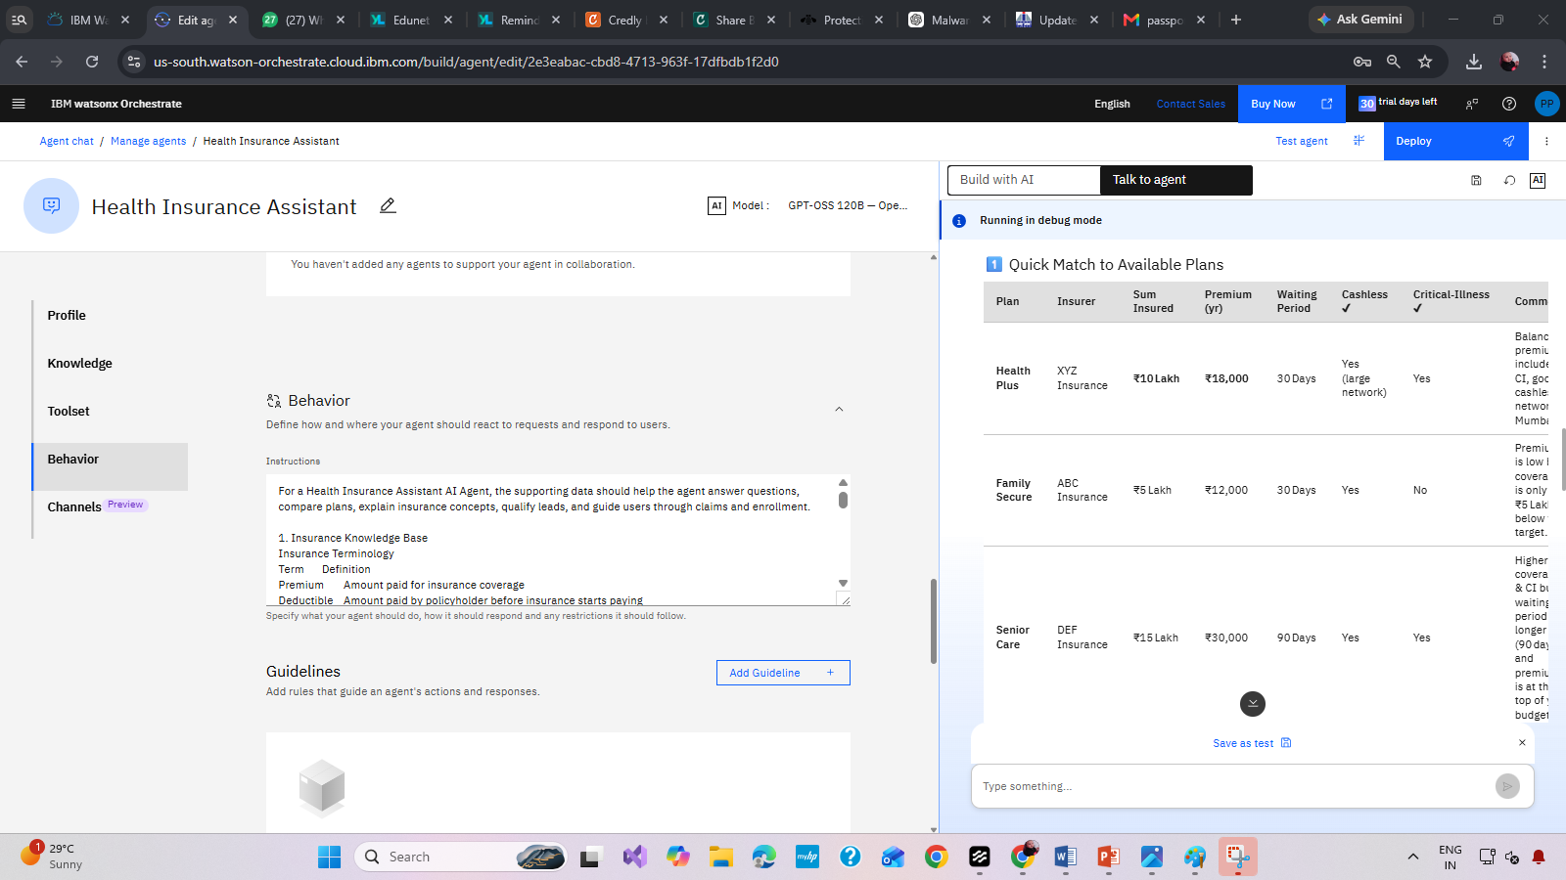
Test-output Health Insurance Assistance AI Agent

Slide 11

Role of Agentic AI in the solution
Role of Agentic AI in Nutrition Agent
Intelligent User Assessment
Collects user information such as age, family size, budget, location, and health requirements.
2. Personalized Policy Recommendations
Recommends suitable insurance plans based on budget and healthcare needs.
3. Insurance Plan Comparison
Presents comparisons in an easy-to-understand format.
4. Claims Assistance
Explains cashless and reimbursement claim processes
5. Automated Customer Support
Handles frequently asked questions 24/7.
6. Decision Support
Supports informed decision-making rather than simply providing information.
7. Continuous Follow-Up

Slide 12
Novelty and Uniqueness
The proposed Nutrition Agent stands out by combining Agentic AI and personalization into a single intelligent system.
Novelty and Uniqueness
The Health Insurance Assistant goes beyond traditional insurance chatbots by leveraging Agentic AI, personalized decision-making, and Retrieval-Augmented Generation (RAG) to provide intelligent, context-aware insurance guidance. Instead of simply answering questions, the agent actively understands user requirements, analyzes multiple factors, and recommends suitable insurance solutions.
This makes the solution a smart, adaptive, and proactive digital nutritionist, not just a static diet recommendation tool.

Slide 13
Git Hub Link
Github URL – https://github.com/pphad036-prp/HealthAIAgent.git
Make sure you have Uploaded following three files into your github repository 1) app.json file , 2) yourproblemstatement.pdf file 3) your projectpresntation.pptx file 4)any other files
·
·
·

Slide 14
Future Scope
1.Integration with Wearables & Health Devices –
The system can be integrated with smartwatches and fitness trackers to collect real-time data such as steps, calories burned, heart rate, and sleep patterns. This will enable the Nutrition Agent to provide more accurate and dynamic diet recommendations based on actual user activity and health metrics.
2.AI-Powered Voice Assistant & Multilingual Support –
Enhancing the system with a voice-enabled assistant and support for multiple languages will improve accessibility. Users can interact naturally in their preferred language, making the solution more inclusive and suitable for diverse populations, especially in regions with varied linguistic backgrounds.
·
·
·

Slide 15


